Slide 1
What’s wrong with this data visualization?
Adapted for CGT 2700 Data Visualization
Group 9

Slide 2
Group 9
Group Members
Instructions
Thomas Birk
Enze Wang
Trae Richardson
Alexander Ashby
Scribe: Thomas Birk
Examine the visualization on the next slide
Determine what’s wrong with the visualization
Then, provide recommendations on how the group would REFINE the visualization
Use any of the resources mentioned in previous lectures and readings

Slide 3
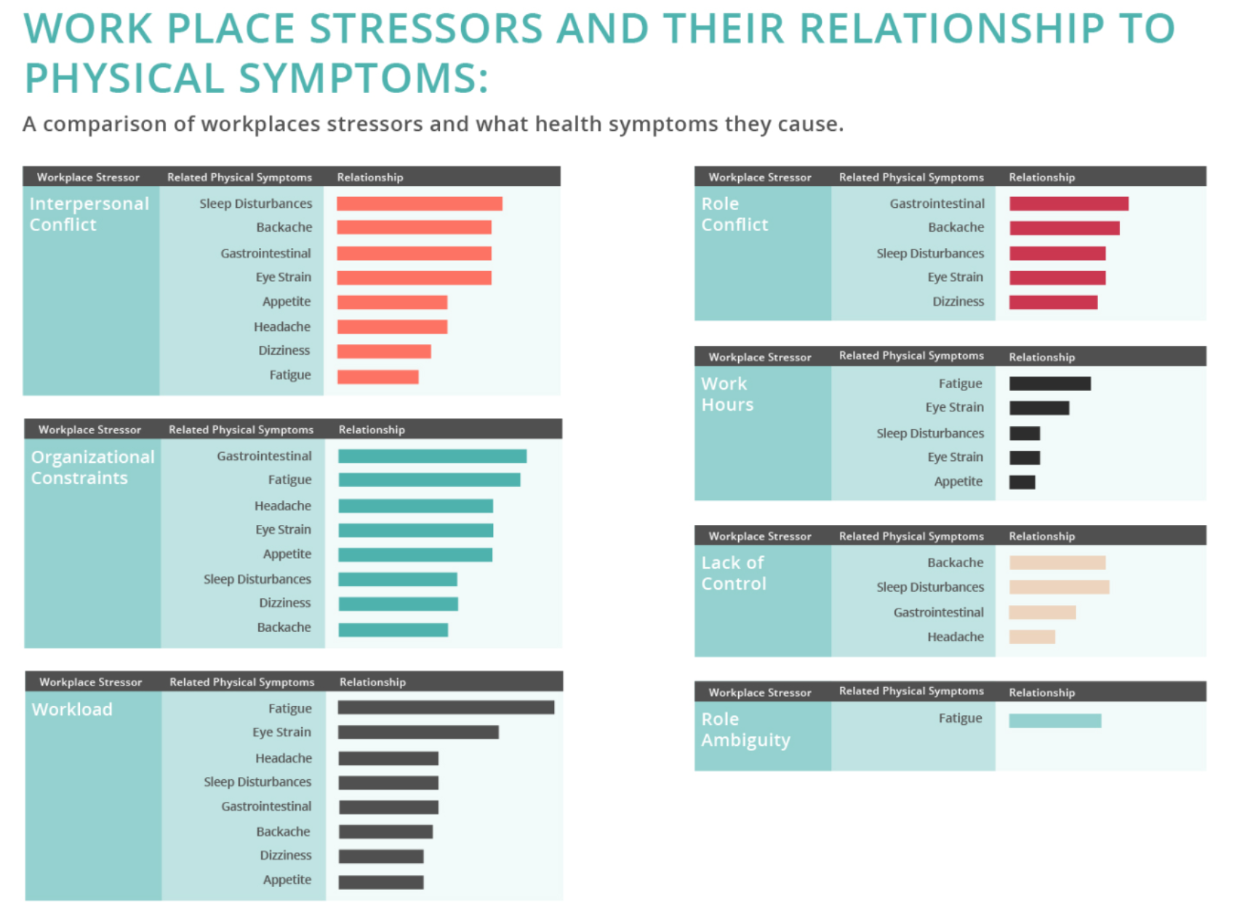

Slide 4
What is it?
This is a snippet of a full graphic created by MPH Today, and is based on a recent peer reviewed article which analyzed “79 studies on the effects of stress and the human body”.

Slide 5
What’s wrong with it?
Relationship bars only show values in comparison to other physical symptoms
There is no clear indication of what the ‘relationship’ is
There are no values on the x-axis to show the values of the relationships
There are so many different graphs that it makes it look unorganized

Slide 6
What should they have done?
Indicate what the relationships are
Indicate the values of the relationships
Reorganize the bar graph and color code it to make them more comparable and cleaner

